Slide 1
ANIL Remote Control Tool Development

Slide 2
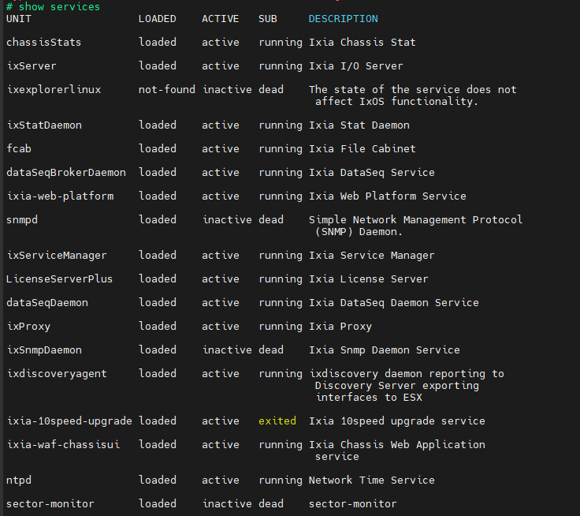

IXIA API
Chassis
Chassis REST API
IxNetwork
L2/L3 control
IxNetwork REST API
IxExplorer
L1 control
No ixtclserver
No ixnetworkWebApi
No ixnetworkServer
Need to contact IXIA support

Slide 3
Function Validations
IXIA Packet setting
  IXIA DA setting
  IXIA Packet size setting
IXIA-E830
  Received packets check
BASE-T Switch AN advertise setting
BASE-T force speed
IXIA-E610
  Received packets check

Slide 4
IXIA – Switch – E830 validation
Non-broadcast packets: DA setting
IXIA-to-Intel NIC packets validation
Arista
13/1
14/1
15/1
16/1
Set DA as 16/1 MAC
Set SA as 13/1 MAC
Set DA as 13/1 MAC
Set SA as 16/1 MAC
IXIA
1.1
2.1
3.1
4.1
Arista
13/1
16/1
IXIA
1.1
Intel NIC
(E830)

Slide 5
IXIA – Switch – E610 validation
Non-broadcast packets: DA setting
IXIA-to-Intel NIC packets validation
IXIA
IXIA
Intel NIC
(E610)

Slide 6
Architecture
LP
(Switch)
UI
  8x DUT/LP
  Speed/Cable config
  LHC config
  Log window
  Switch config
  Switch log window
  IXIA config
  IXIA log window
Traffic Gen
IXIA/NIC
DUT
Intel NIC
DUT
Intel NIC
LP
IXIA/NIC

Slide 7
Development Flow Phase 1
Switch Enabling
EthAgent Enabling
SSH connection
TCP/IP connection
COM port connection
IXIA Enabling
Function Enabling
Function Enabling
Function Enabling
Switch Port
Check status/counters
Clear counters
Send/Stop Package
Change Speed
Link down/up
Save log
ARCT(ANIL Remote Control Tool)
Manual select action

Slide 8
Development Flow Phase 2 (Automation)
Switch Enabling
EthAgent Enabling
IXIA Enabling
Function Enabling
Function Enabling
Function Enabling
TTL
BER
Replace LP with IXIA
Change Speed
IXIA status/counter log
Switch status/counter log
New LHC

